Slide 1
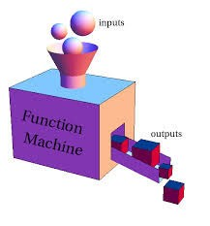

COA123 Web Programming
Week 3: Lec3- A
Writing functions for DHTML
Dr. Baihua Li

Slide 2

Learn outcomes
Programmer-defined Function
Function declaration, call, returns
Formal/actual parameters
Variable scope: global vs local
HTML Forms
DHTML with JavaScript (User interaction)

Slide 3
Name a built-in function
alert(string parameter)
• prompt(…,[…])
Number(…), parseInt(…)
Associated with objects:
String obj: s.indexOf(…), s.substr(…,…), s.substring(…,…), s.charAt(…), s.toUpperCase(), s.toLowerCase()
Math obj: Math.round(…), Math.floor(…), …

Slide 4
Programmer-defined function
more readable
less error prone
re-usable
Declare a function:
function identifier(parameter1, parameter2, …)
{
statement1 ; statement2 ;
….
}

Slide 5

A simple function
A simple function with one statement and no parameter
function dosth() // declare a function alert("doing sth");
dosth(); // Calling a function:

Slide 6
Exp 5.1function declaration/call
var v="a", w="b";
function f1(){v+="c"; w+="d";} // declaration function f2(){v+="e"; w+="f";} // declaration
f1(); f2();
alert("v="+v+";w="+w);
// call function
// v=ace;w=bdf
v="a"; w="b"; f2(); f2(); f1();
alert("v="+v+";w="+w);
// v=aeec;w=bffd

Slide 7
Two main flavours of functions
Get the job done :
function destroyUniverse() { alert(“destroyed!”);
};
Produce a return value: function getSomething() {
var answer = prompt("Enter something:"); return answer;
};

Slide 8
Return result
when returning values:
add a return statement inside the function, signal a result of a function
the call of the function is now placed in a position where a value is expected
var sth=getSomething(); alert(sth);
or alert(getSomething());
5.2 - return result

Slide 9
Parameters
hardcoded values ☹
var a = 10, b = 5; function add() {
var c=a+b; return c;
}
To make the function more general, we use parameters function add(a, b) {
var c=a+b; return c;
}
alert(add(5,10)); var x=8; y=-20; alert(add(x,y));
alert(add("hello ", "world"));

Slide 10
Formal & actual parameters
Formal parameters
Parameters in the declaration of the function
Actual parameters
Parameters in the call of the function to replace the formal parameters
function add(a, b) { return a + b;
}
var n1 = 10; var n2 = 2; add(n1, n2);
add(4, 2);
5.3 - (formal, actual) parameters

Slide 11

Multiple returns
A function can have several return statements, such as in both branches of a conditional.
Whenever a return statement is executed, it immediately ends the function.
e.g. Get the absolute number of an input digital
var n=Number(prompt("enter a number")); alert(abs(n));
function abs(v){
if (v>0)
if (v<=0)
return v; return -v;
}

Slide 12
Function in code flow
How does it look on our code flow diagram?
Begin Statement
Statement 1
Function
Statement m
Function
Function
End Statement

Slide 13
Variable scope
Variables are created when the line of declaration is executed during execution.
The scope of a variable is the part (block) of the program where its value can be accessed or changed.

Slide 14
Global vs Local variables
Global variables – variables declared outside of a function
– Can be referred to from within any functions in the program
destroyed at the end of a program
only created and destroyed once
Local variables – variables declared inside a function
Only be referred to within the declaration function
Deleted at the end of the function in which they are declared.
created and destroyed whenever the function is called

Slide 15

















Global/ local variables
a
b
Global variables
var = 10, = 5; function add ) {
(a
,b
a
= + 1;
= + 1;
return + ; var
a
b
b
Local variables
a
b
ImALocalVariable
= ‘whatever’;
}
alert(add aler
alert
(a
b
alert(add(10,5)); 17
, ));
t(a);
alert(10); 10
(ImALocalVariable
);
Not defined

Slide 16
5.4 - global, local variables, scope
var g=0; // global function f1(p1){
var v=1,v1=2; // local v,v1 alert(v+","+v1+","+p1+","+g);
} f1(5);
1,2,5,0
function f2(p2){
var v=3,v2=4; // local v,v2 alert(v+","+v2+","+p2+","+g);
} f2(6);
3,4,6,0
function f3(){var g=7; alert(g);} function f4(){g=g+1;alert(g);}
// g is local to f3
// back to global g
f3(); f4(); alert(g);
7
1
1

Slide 17
Good programming practice
Modularity: ensure that all (or as many as possible) variables used by a function are declared as local variables, and use parameters to pass on data from the outside of the function.
It is common for different functions to use local variables with the same names.
– e.g. i, n as counter used in several functions

Slide 18
HTML form elements
Web Programming
Writing JS functions for DHTML

Slide 19
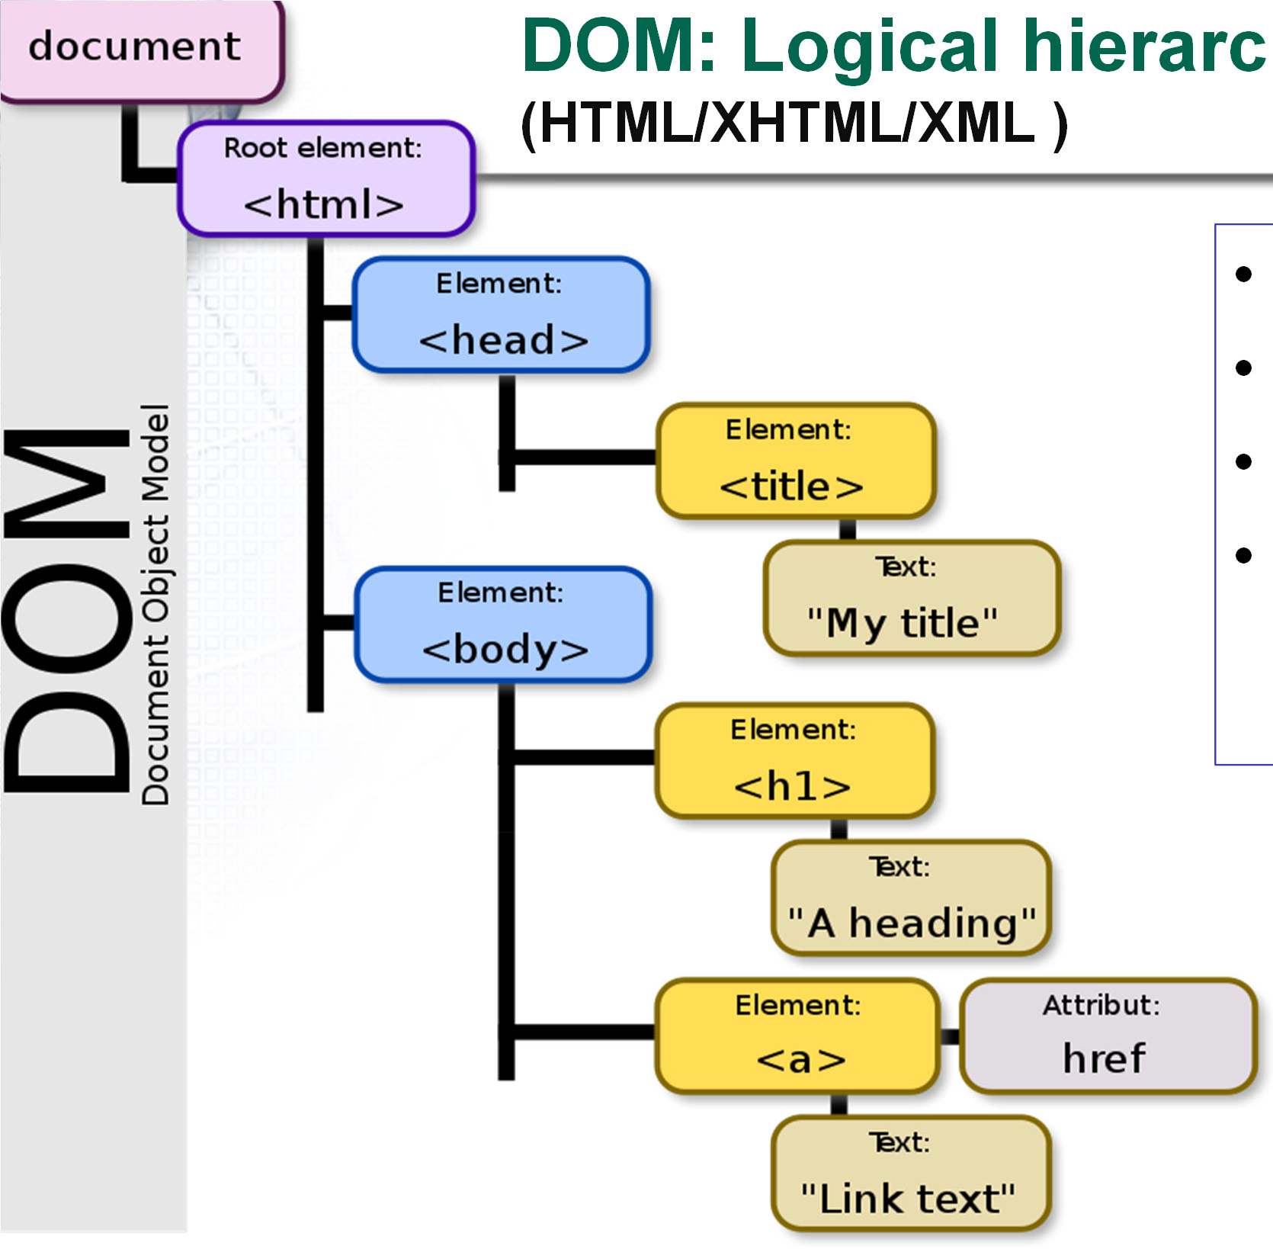
hical tree
DOM: Logical hierarc
(HTML/XHTML/XML )
•
•
•
•
Branch Node Object
Event handler

Slide 20
Document Object Model (DOM)
DOM is a cross-platform and language-independent programming interface that treats an HTML/XHTML/XML document as a logical tree structure
Each branch ends in a node, each node contains object(s) representing a part of the web document.
Nodes can have event handlers attached to them. Once an event is triggered, the event handlers get executed.
DOM allows programmatic access to the tree, e.g. change structure, style or content of a document.

Slide 21
DHTML
Allow user interaction, respond to events, e.g. click, mouse-up, hover
Accept user input and send the information to a web server as a query string
We can cerate such dynamic and interactive elements using HTML form elements with user- defined JS functions.
Document
DOM
Form
Textbox (user)
TextBox (password)
Textarea(information)
Button (submit)

Slide 22
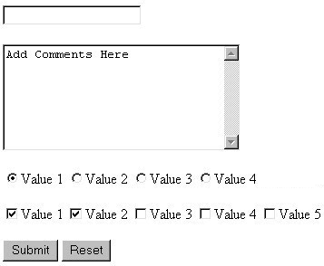
HTML Forms (W3school)
<form>
<input | type= “…” | … | >
<input | type= “…” | … | >
….
</form>
Use <input> in the <form> tag to declare group of input controls, allowing users to input data.
type attribute: “text”, “submit”,
JavaScript can be used to create interactive behaviours via event handler

Slide 23


Text fields
Attributes:
•size: onscreen width of text field
•Maxlength: mix-number characters user is able to type into field
•Readonly: text cannot be modified

Slide 24
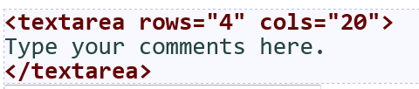
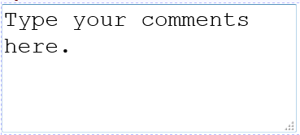
<textarea>
a multi-line text input area.
– initial text is placed inside textarea tag (optional)
rows and cols: height/width in characters

Slide 25





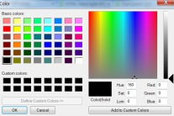



<input type = " " ….. >
text/textarea (multi-lines)
checkbox/radio (one-out-of-n)/selection
button/reset/submit
hidden/password (masked)
file
/image
email(< 9 )
date/ time/datetime/week/month
color/number/range
Search/url <( )
9
But no Combo Box & List Box in form

Slide 26
Button: onclick event (6.2)
An event handler for a button can be implemented by Javascript as the value of the onclick attribute
<form>
<input type='button' value='clickme' onclick='alert("Hi");' />
</form>

Slide 27
JS function
Declaring a JS function:
function identifier(parameter1, parameter2, …)
{
statements ;
…. return x;
}
5.1 - (programmer-defined) function
5.2 - return result
5.3 - (formal, actual) parameters
5.4 - global, local variables, scope

Slide 28
Function call (6.3)
Place longer scripts in the head of the document as a function(s)
Enclosed in <script>...</script>,
Event handler becomes a function call.
<script
type='text/javascript'> function doit(){ alert(‘Hi');
}
</script>
……
<form>
<input type='button' value='clickme' onclick='doit();' />
</form>

Slide 29
Function call with parameters
<script
type='text/javascript'> function doit(v){ alert(v)
}
</script>
……
<form>
<input type='button' value='clickme' onclick='doit(“done”);' />
</form>
Better to use variables as function parameters !
<input> event handler
– onmouseup, onclick, onchange

Slide 30
onchange & this.value (6.4)
onchange: when text is changed & the box loses focus
this: pseudo-variable to address current object
<form>
<input
type='text' onchange='alert(this.value);' />
<textarea onchange='alert(this.value);'>
</textarea>
</form>

Slide 31
Addressing in DOM
document.form_name.element_name
hierarchy of objects in Document Object Model (DOM)
a button belongs to a form, a form belongs to a document
document.getElementById(element_id)

Slide 32

Addressing (6.5)
<html>
<head>
<script type='text/javascript'> function f(v){
document.getElementById("text2").value =v.toUpperCase();
}
</script>
</head>
<body>
<form name='form1'>
<input type='text' name='text1' />
<input type='text' id='text2' />
<input type='button' value='upperCase' onclick='f(document.form1.text1.value);' />
<input type='button' value='copyme' onclick='f(this.value);' />
</form>
</body>
</html>

Slide 33
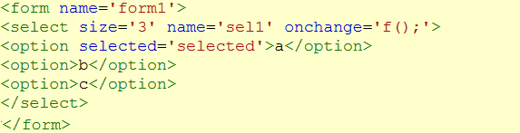

<select> menu (6.6)
– <select> ... </select>
<select size=‘3' name='sel1' onchange='f();' >
<option> …. </option>
<option selected='selected'> … </option>
selectedIndex
•zero-based index of the currently selected item document.form1.sell.selectedIndex

Slide 34

Checkboxes (6.7)
<input type='checkbox'... />
each checkbox is an independent choice
if a checkbox is selected, then its checked attribute value is ‘true’
<input type='checkbox' name='cb1' value='sugar' checked = 'true' />

Slide 35

Radio button 6.8
One-out-of-n choice
<input type='radio' ... />
<input type='radio' name='rad1' value='water' checked='checked' />

Slide 36
Exe 6.5 Copying text (1)
Make b1 copy from text1 to text2 but changing the text to lowercase.
Make b2 copy from text1 to text2 but changing the text to uppercase.

Slide 37
Exe. Copying text
<body>
<p> 2 text entry elements with 2 buttons</p>
<form name='form1’>
<input type='text' name='text1' />
<input type='button' value='b1' onclick='f("lower");' />
<input type='text' id='text2' />
<input type='button' value='b2' onclick='f("upper");' />
</form>
</body>

Slide 38
Exe. Copying text
<head>
<script type='text/javascript’> function f(caps){
if(caps=="upper"){ document.getElementById("text2").value
=document.form1.text1.value.toUpperCase();} if(caps=="lower"){ document.getElementById("text2").value
=document.form1.text1.value.toLowerCase();}
}
</script>
</head>

Slide 39

Exe 6.6. changeCase
Write a changeCase form which has two text boxes and a select menu. The menu has three options (copy, uppercase, lowercase). After text
is entered, and a menu option selected, the text is copied to the second textbox (or made uppercase or lowercase) according to the menu choice.

Slide 40
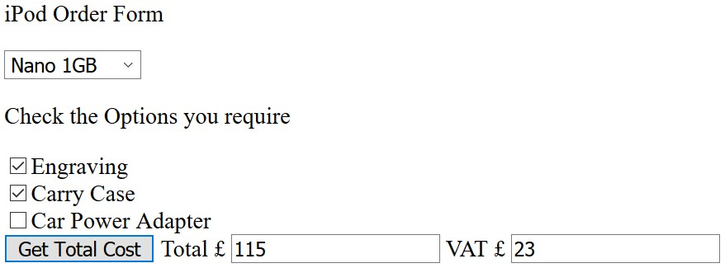
Exe 6.7 iPod order form
4 basic choices: Nano 1GB £90, Nano 4GB £155, Video 30GB £200 or Video 60GB £275.
3 options: engraving (£10), carrying case (£15), car power adapter (£18).
Results: order total and the VAT .

Slide 41

Week2 Exe: jQuery (option)
<html>
<head>
<script type="text/javascript" src="https://ajax.googleapis.com/ajax/libs/jquery/1.9.0/jquery.min.js">
</script>
<script type="text/javascript"> function f(){
var v=document.fm.tb.value; document.getElementById("tb2").value=v.toUpperCase();
//$("#more").html("<p>Hello World!</p>");
//$("#tb2").val( $("input[name=tb]").val().toUpperCase() );
}
</script>
</head>
<body>
<form name="fm">
<input
<input
<input
type="text" name="tb" /> type="text" name="tb2" id="tb2" />
type="button" value="Click" onclick="f();" />
</form>
<div id="more"></div>
</body>
</html>
DHTML Tester

